Slide 1

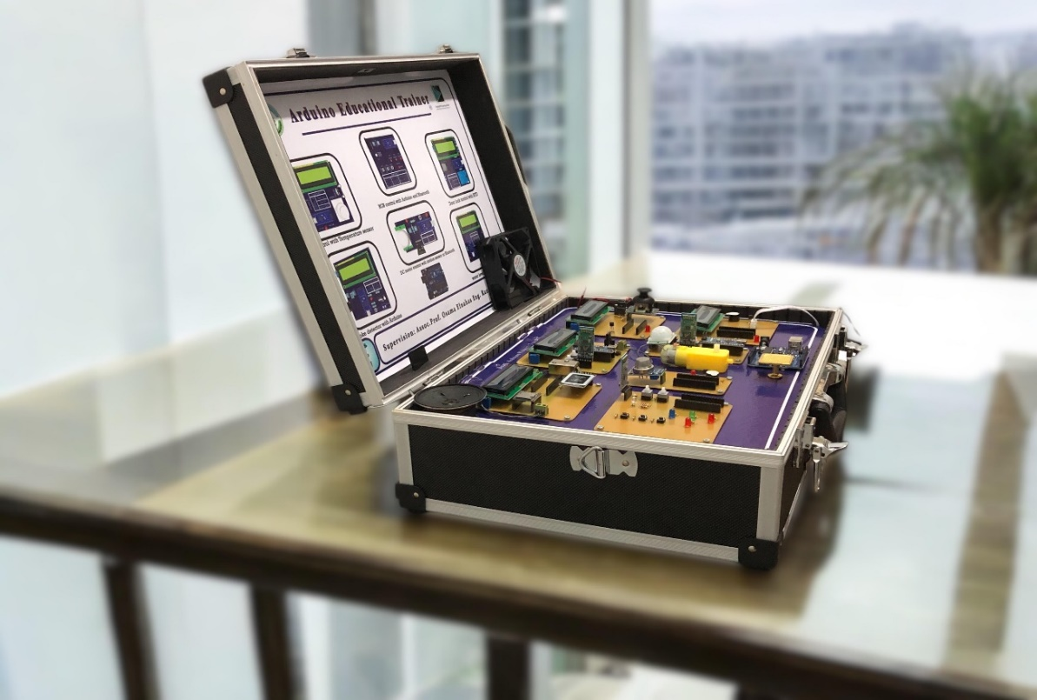


BATU Arduino Training Bag
Arduino Educational Trainer Catalog
“Shape the future of electronics by sparking innovation today.”
Under Supervision: Prof. Osama Elnahas Co-Supervision: Prof. Eman Shawky

Slide 2



Slide 3
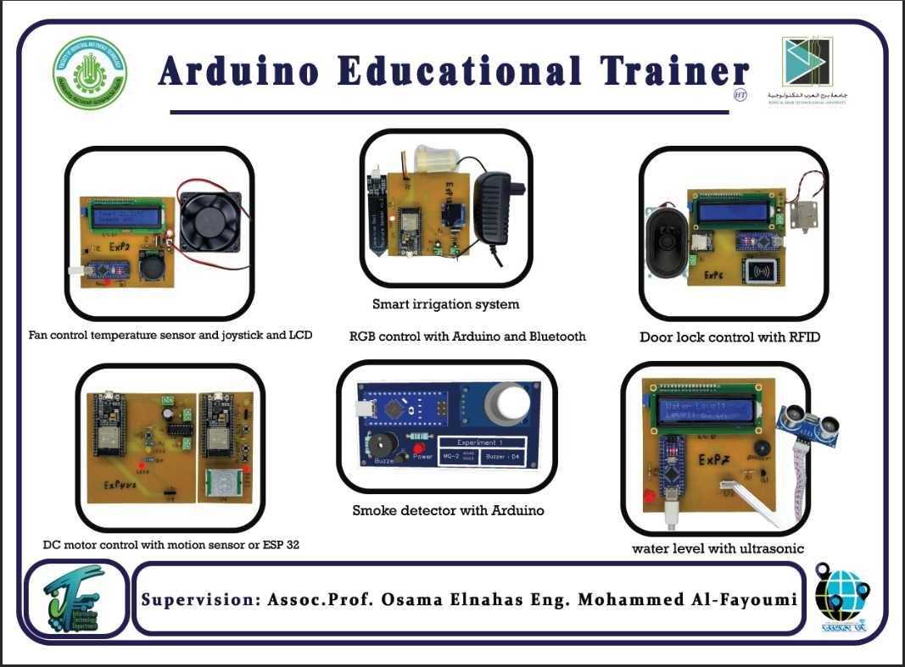
Welcome to our world of future of electronics
The educational experiment kit offers a comprehensive set of practical projects to learn modern technologies. The experiments include the LoRa WAN system for long-range communication, ESP32 MQTT for smart irrigation, door lock control using RFID, DC motor control via Wi-Fi, and fan control using a temperature sensor and joystick with speed displayed on an LCD. This kit is an ideal tool for students and enthusiasts to understand smart applications practically and effectively.

Slide 4
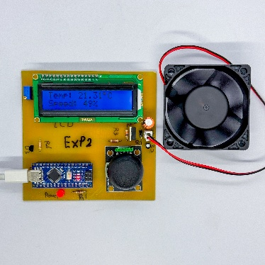
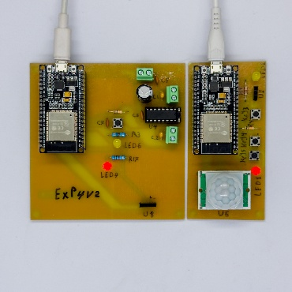
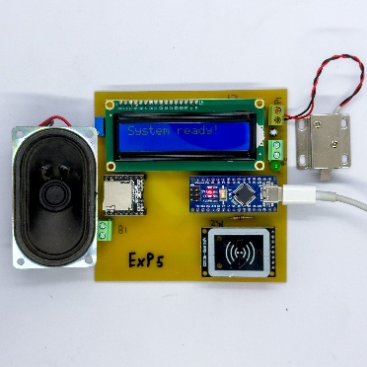
Fan control with temperature sensor and joystick and show speed on LCD
The project controls fan speed via a temperature sensor and joystick, with PWM adjustment. An LCD displays speed for easy monitoring and control.
Experiment 1
DC Motor With Wireless Control
A wireless motor control system using an nRF24L01 module, with real-time status updates on an OLED screen for enhanced usability and monitoring.
Experiment 2
Door Lock Control
An rfid-based locking system unlocks with authorized cards. A red LED shows power status. Suitable for homes, offices, and secure areas.
Experiment 3

Slide 5
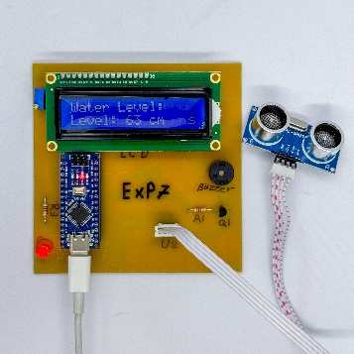
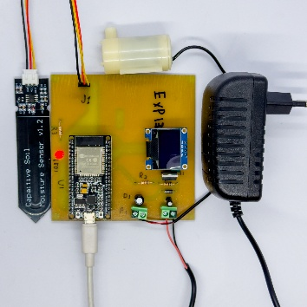
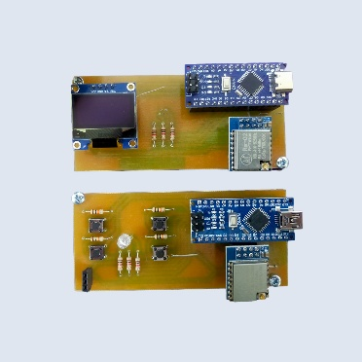
Experiment 4
Water level measurement with ultrasonic
An ultrasonic system measures and displays water levels via a microcontroller and LCD. It's ideal for homes, agriculture, and industrial water management.
Experiment 5
Smart irrigation system
An ESP32 MQTT system automates irrigation using soil moisture sensors. It controls watering via a pump and provides smart, efficient plant care management.
Lora wan
Lora WAN is a low-power iot protocol enabling long-range, cost-effective communication using lora modulation for efficient wide-area data transmission.
Experiment 6

Slide 6
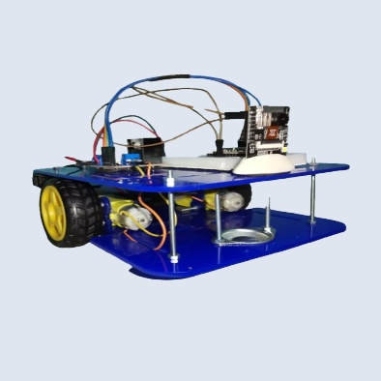
ESP32-CAM Streaming and Remote Control
Experiment 7
The car is designed to be controlled remotely via a controller, allowing for navigation and operation. The ESP32-CAM streams live video to a web application, enabling users to see what the camera captures in real-time. This integration of components facilitates an interactive and engaging experience, combining mobility with visual feedback.

Slide 7



Experiment 1
Fan control with temperature sensor and joystick and show speed on LCD
The project aims to control the fan speed using a temperature sensor to measure the temperature and a joystick to manually adjust the speed.The microcontroller (suchasarduino)reads the temperature from the sensor, and when the temperature increases, the fan speed is automatically adjusted using PWM. The user can also manually change the speed via the joystick. The LCD screen displays the current fan speed, making it easy to monitor and control the system flexibly.

Slide 8
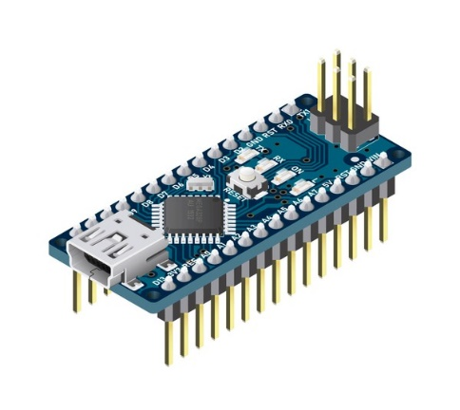
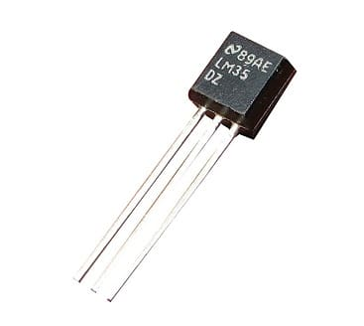
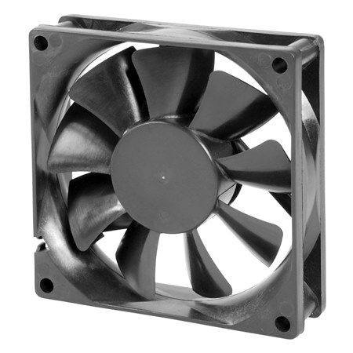
I. Components
1x arduino nano
It is a small microcontroller used as the "brain" of the project to control other components.
1
1x temperature sensor
The temperature sensor measures the surrounding temperature or the temperature of a specific object
2
1x fan
Its function is cooling or moving air to reduce temperature or improve ventilation
3

Slide 9
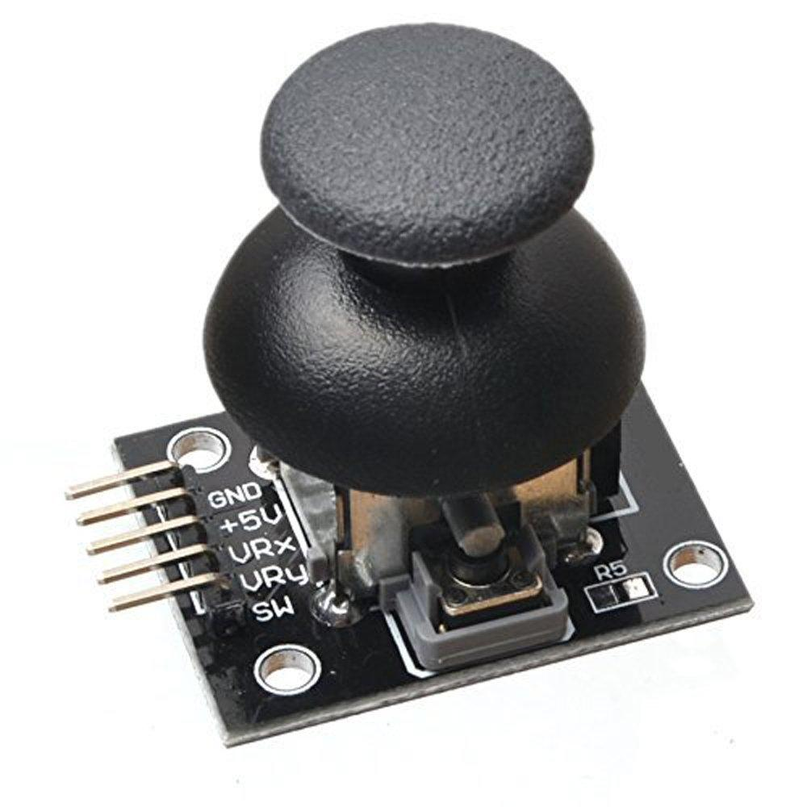
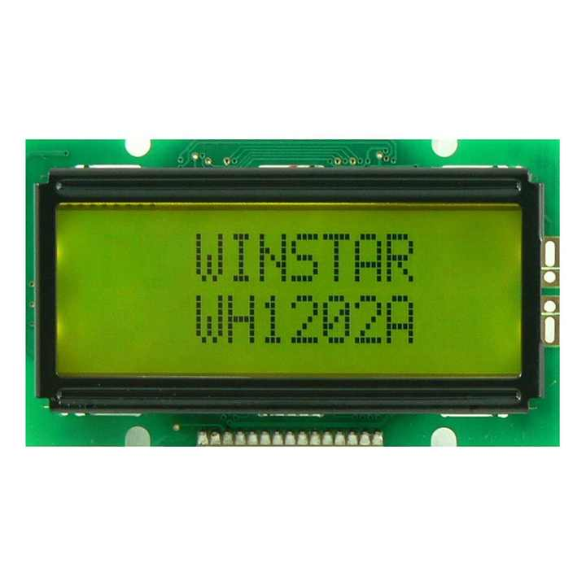
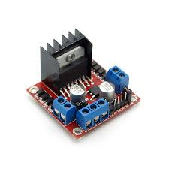
I. Components
1x joystick
It is an input device used for manual control of any system
4
1x LCD
Its function is to visually display information, such as measured values (temperature), speeds, or any textual messages.
5
1x driver
Controlling the operation of motors, stopping them, changing their speed, or altering their rotation direction.
6

Slide 10
Fan control with temperature sensor and joystick and show speed on LCD
Reference | Component | Value | Quantity
U1 | Arduino Nano | - | 1
LCD1 | LCD Display | HS1602A | 1
U2 | Joystick Module | - | 1
U3 | Temperature Sensor | DS18B20+ | 1
H1 | DC Fan | - | 1
D3, D1 | Diode/LED | LED-TH-5mm_R, 1N4007 | 2
Q1 | MOSFET | 2SK2341-AZ | 1
R1, R5 | Resistor | 1kΩ | 2
R2, R3 | Resistor | 10kΩ | 2
R4 | Resistor | 220Ω | 1
R6 | Resistor | 4.7kΩ | 1
C1, C2 | Capacitor | 220µF, 1µF | 2

Slide 11
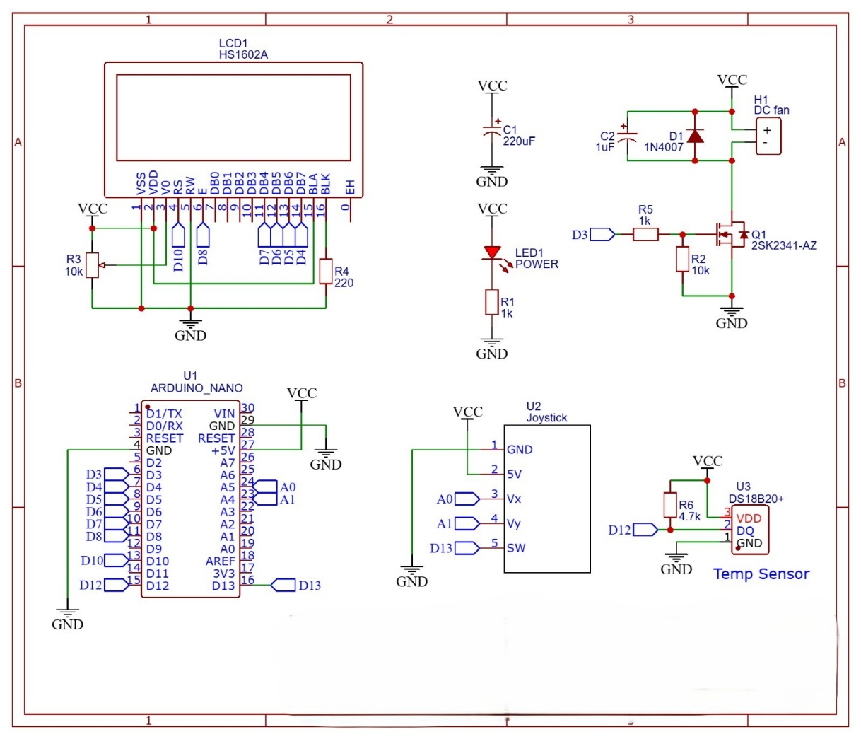
II Schematic

Slide 12

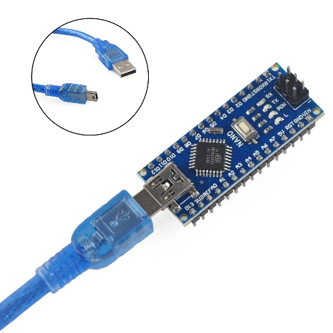
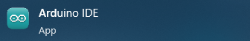
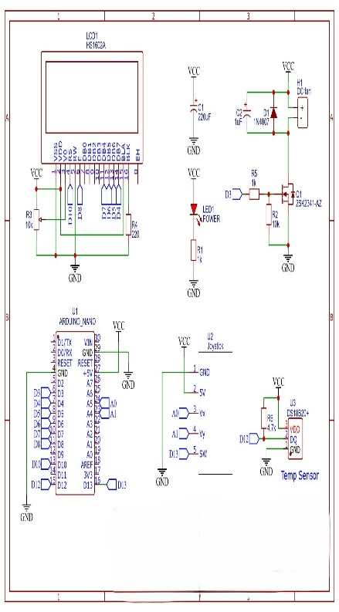
Experiment 1
Step 1
Connect the Arduino Nano
Plug the Arduino Nano into your computer using a USB cable.
Open the Arduino IDE on your computer to begin writing the code.
Step 2
Connect the Components
Wire the LCD, fan, joystick, and temperature sensor as per the schematic.
Ensure all connections are correct and secure.

Slide 13
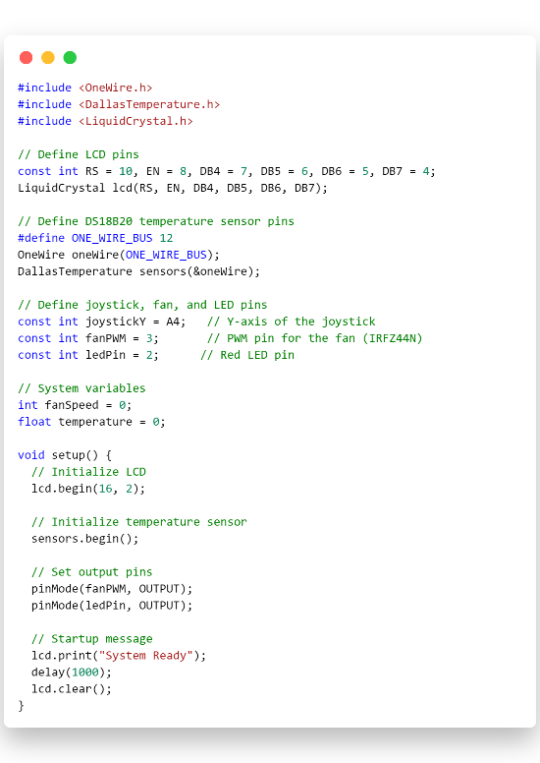
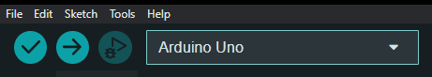
Experiment 1
Step 3
Write the Code
Use the Arduino IDE to write a program that:
- Reads temperature data from the DS18B20.
- Displays the temperature on the LCD.
- Controls the fan speed using the joystick input.
Step 4
Compile and Upload the Code
- Upload the program to the Arduino Nano.
- Verify that the data is displayed correctly on the LCD.

Slide 14


Experiment 1
Step 5
Assemble the PCB
After testing the circuit, mount all components onto the PCB.
Secure the LCD, joystick, and other components in their designated positions.
Step 6
Test Your Code
- Power the circuit and verify its functionality.
- Check the temperature readings on the LCD.
- Adjust the joystick to control the fan speed.

Slide 15
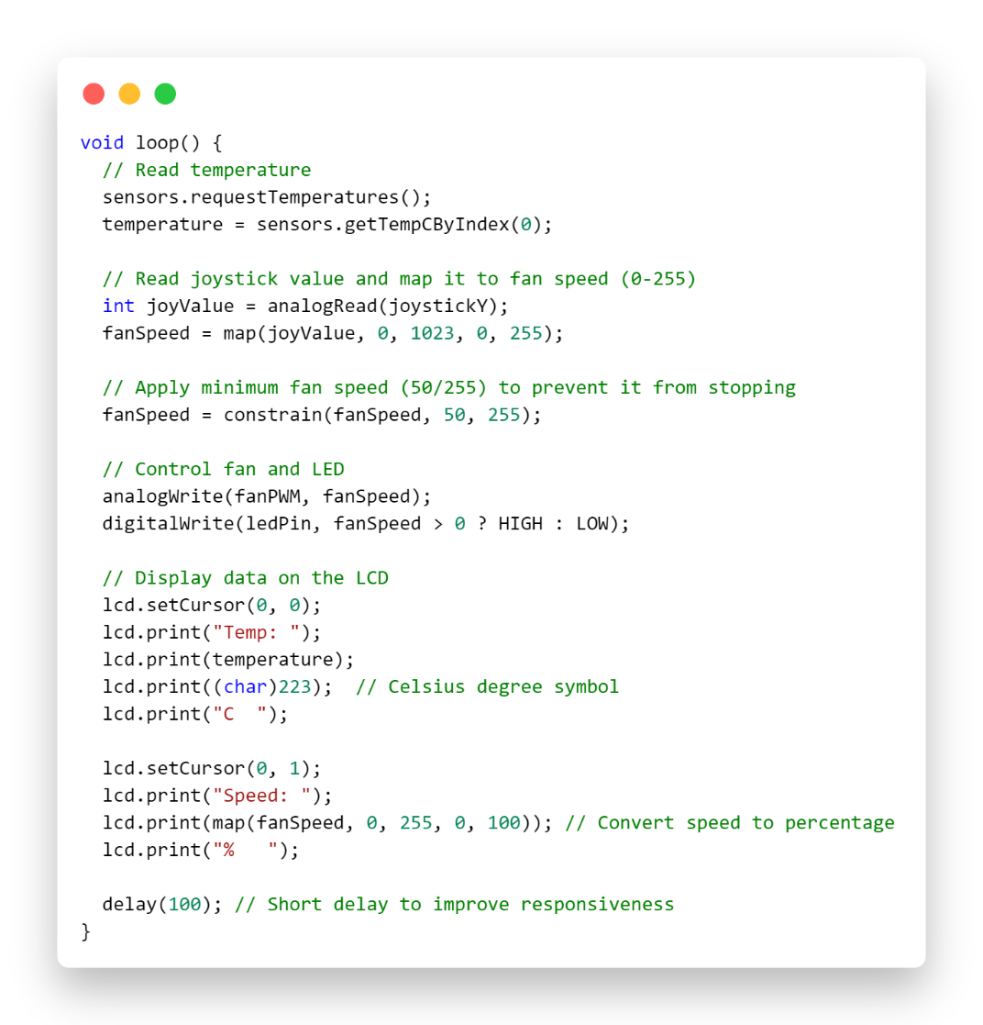
III Experiment
Step 7
Troubleshooting
- If the system doesn’t work as expected:
- Double-check all wiring connections.
- Re-upload the code to the Arduino.
- Ensure the power supply is sufficient for all components.

Slide 16

IV. Code

Slide 17
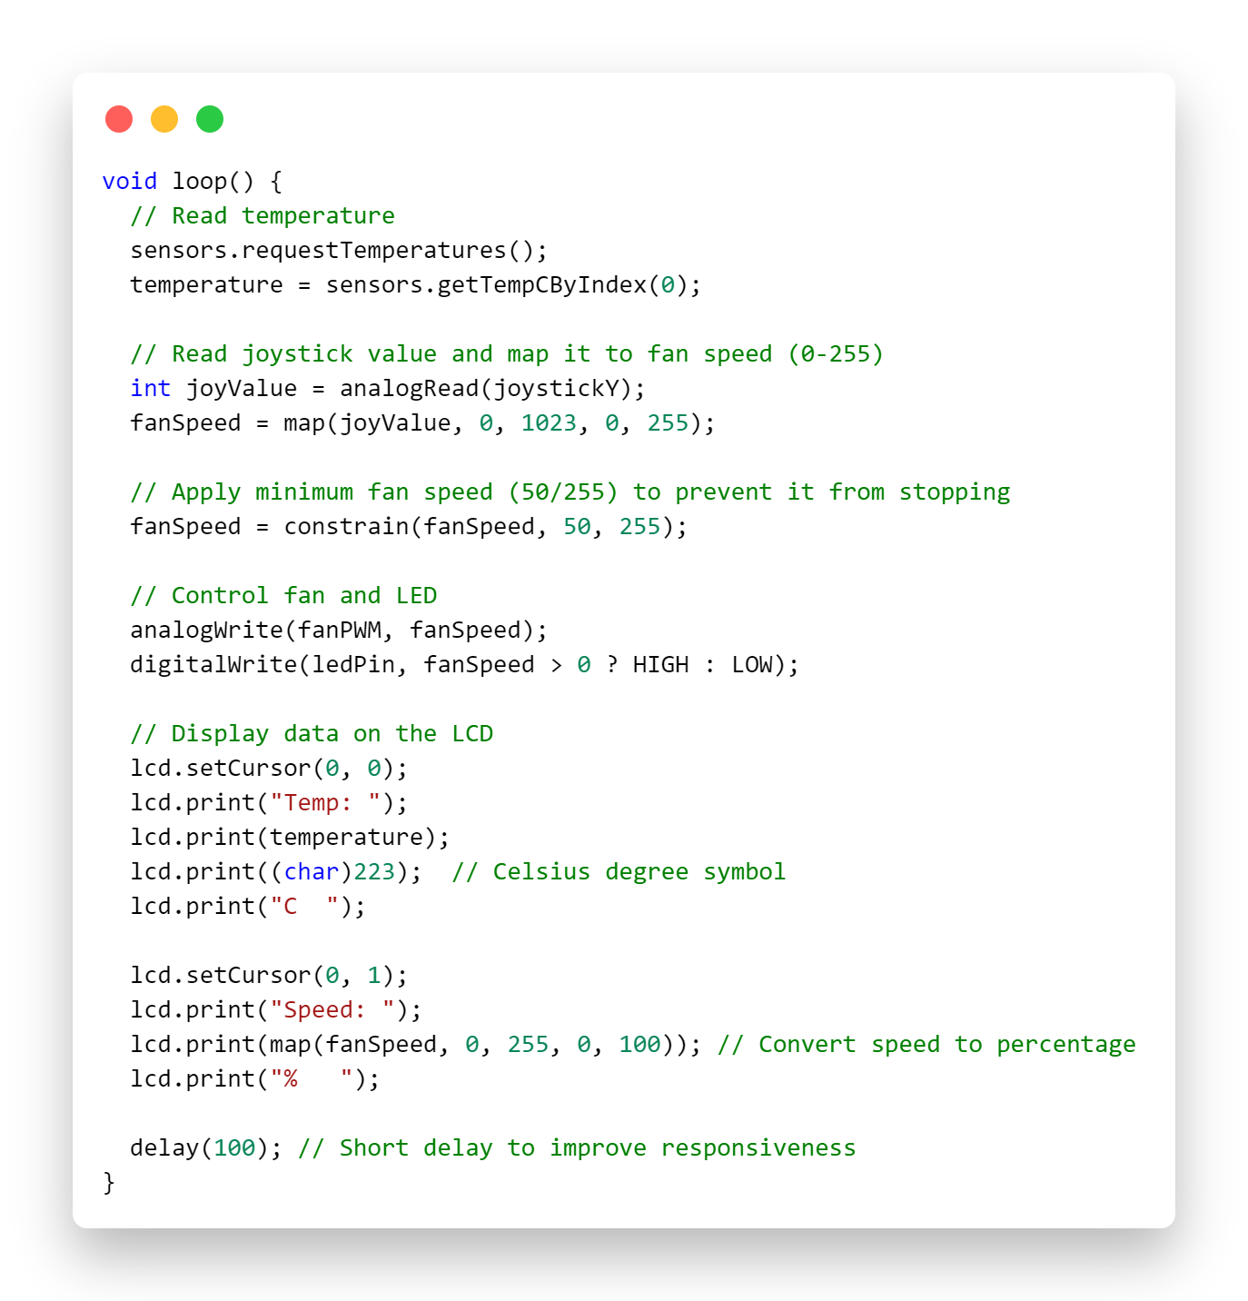
IV. Code

Slide 18
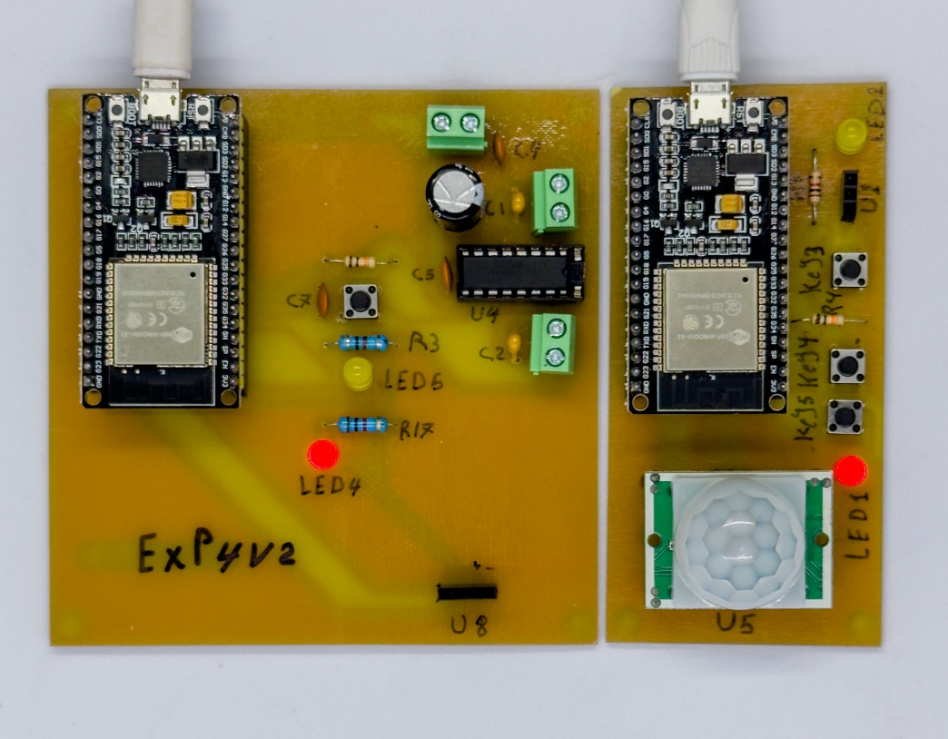
Experiment 2
DC Motor With Wireless Control
This Project Demonstrates A Wireless Control System Designed To Control Motor Directions Using An Nrf24l01 Wireless Module, With Feedback Displayed On An OLED Screen. The System Receives Commands Wirelessly And Interprets Them To Perform Specific Actions, Such As Moving Forward, Backward, Or Stopping. The OLED Display Provides Real-time Status Updates For Better Usability And Monitoring.

Slide 19
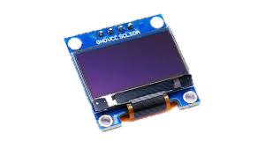
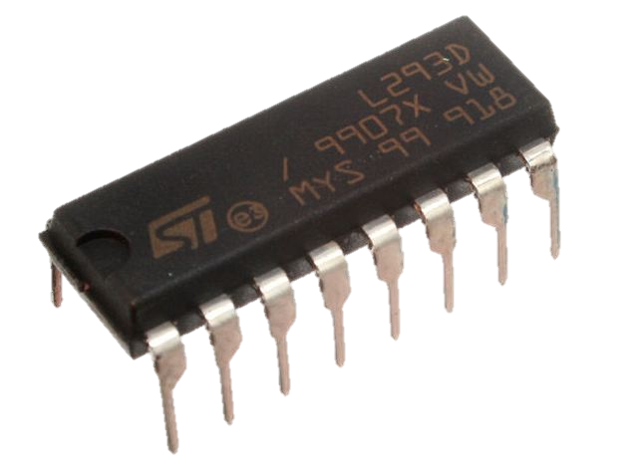
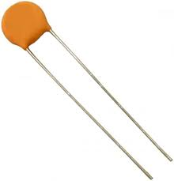
I. Components
1x OLED SSD1306 0.96in
A 0.96-inch OLED display module for text and graphics, supporting I2C and SPI interfaces, ideal for low-power applications.
1
1x L293D Quadruple Half-H Motor Driver IC
A dual-channel motor driver IC for controlling the direction and speed of two DC motors, ideal for robotics and motorized projects.
2
2x Ceramic Capacitor 220nF 50V
High-quality 50V capacitors for decoupling, noise suppression, and energy storage in electronic circuits.
3

Slide 20
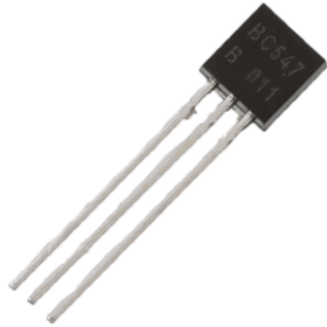
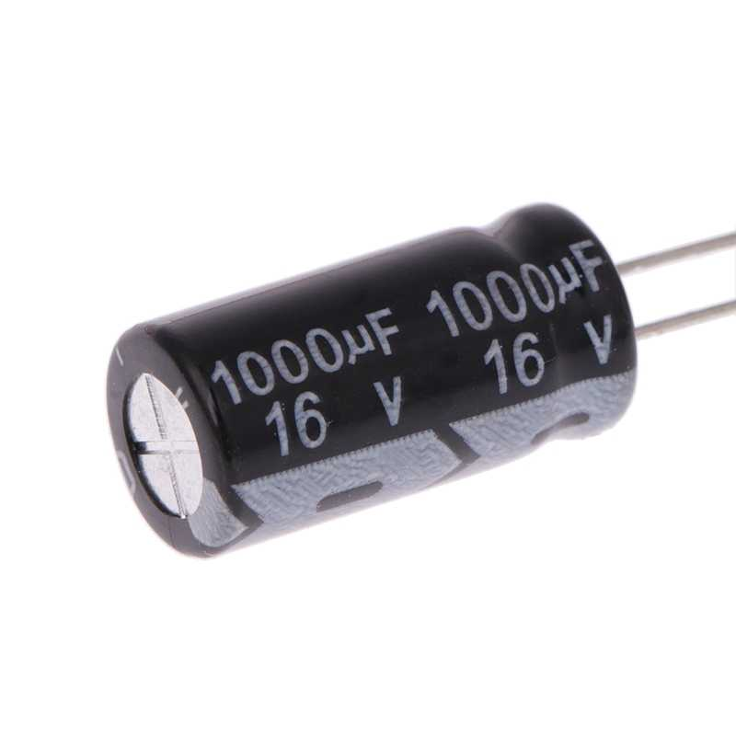
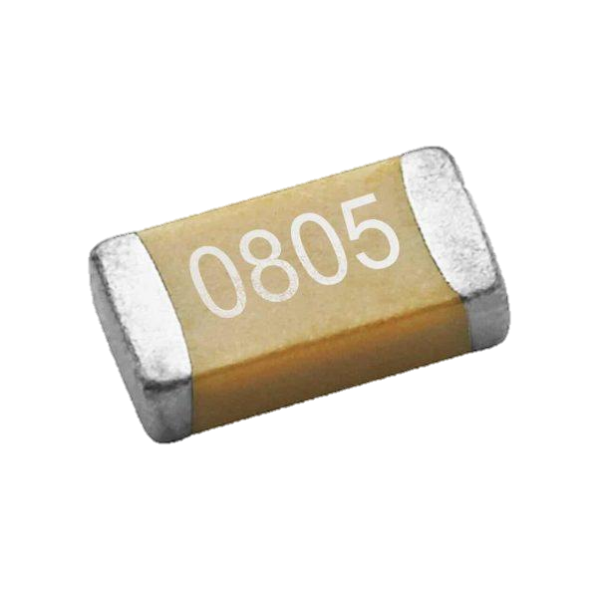
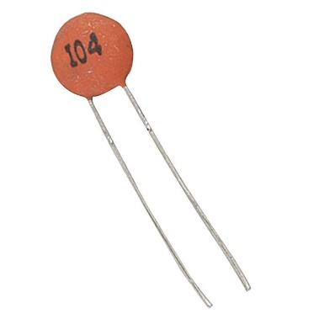
I. Components
1x Capacitor 1000uF
A high-capacity electrolytic capacitor for power smoothing, filtering, or energy storage in power supply circuits. Rated at 16V.
4
3x MLCC – SMD/SMT 100nF
Surface-mount ceramic capacitors (Multilayer Ceramic Chip) used for decoupling and noise filtering in compact PCB designs.
5
3x Ceramic Capacitor 100nF 50V
Standard ceramic capacitors with 100nF capacitance, perfect for decoupling and general-purpose applications. Rated for 50V.
6

Slide 21
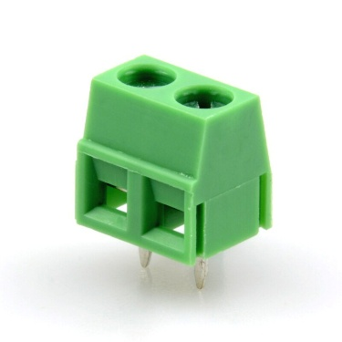
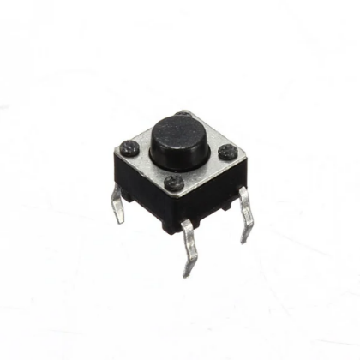
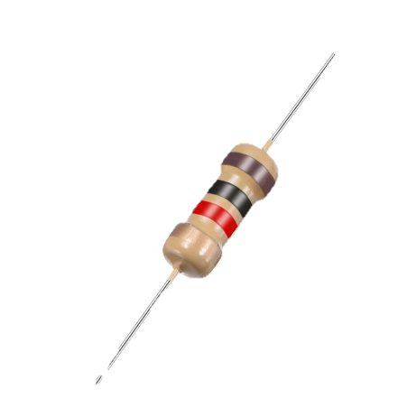
I. Components
3x Terminal Block 2
Pins KF126-5.0-2P
Screw terminal connectors for easily securing wires to a circuit board. Widely used in power supply or industrial applications.
4
4x Mini Push Button
Small tactile switches designed for user input in electronics. Commonly used for reset buttons or user interfaces.
5
4x Resistor 10k
Fixed-value resistors with a resistance of 10 kilo-ohms. Used for voltage division, current limiting, and pull-up or pull-down applications.
6

Slide 22
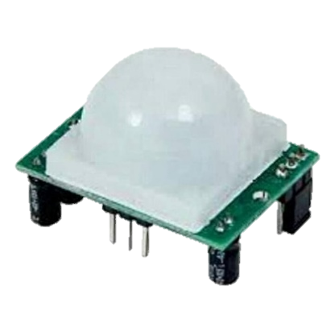
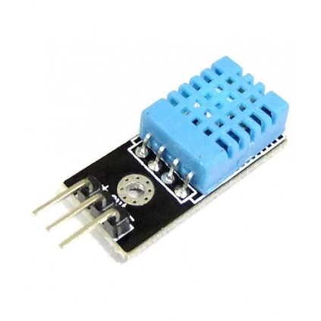
I. Components
4x Resistor 1k
Fixed-value resistors with a resistance of 1 kilo-ohm. Versatile and widely used in circuits for current regulation and signal conditioning.
7
1x PIR HC-SR501
A Passive Infrared (PIR) motion sensor for detecting movement. Commonly used in security systems, lighting automation, and presence detection.
8
1x DHT11
A digital sensor for measuring temperature and humidity. Easy to use with microcontrollers like Arduino or Raspberry Pi.
9

Slide 23
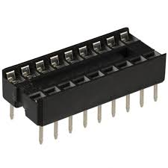
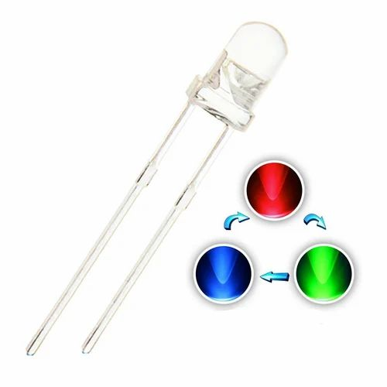
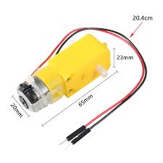
I. Components
1x Base IC 18 Pins
A socket designed to hold 18-pin integrated circuits, allowing easy replacement or mounting on a circuit board.
10
3x LED-TH-5mm (2 red, 1 blue, 1 green)
Standard 5mm through-hole LEDs in red, blue, and green colors. Useful for indicating statuses or adding visual effects in projects.
11
2x DC Gearbox Motor
Compact DC motors with built-in gearboxes for increased torque and reduced speed. Ideal for robotic and mechanical applications.
12

Slide 24
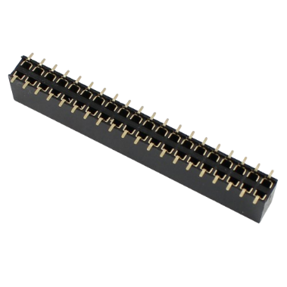
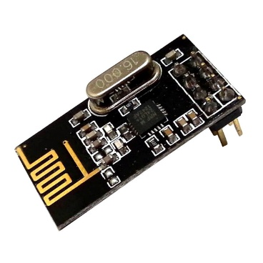
I. Components
3x Pin Headers Female 2.54mm: 40-Pin
Female pin header connectors with a 2.54mm pitch. Often used for connecting modules, boards, or components in electronics.
13
2x nRF24L01+ Wireless Module
The nRF24L01+ is a low-power 2.4 GHz RF transceiver module, ideal for IoT, wireless sensor networks, remote controls, and embedded systems.
14

Slide 25
DC Motor with wireless control
Reference | Component | Value | Quantity
U2, U3 | ESP32-DEVKITC | - | 2
U5 | HC-SR501 PIR Sensor | - | 1
LED1, LED2, LED3, LED4 | LED (Red) | - | 4
U1 | DHT11 | - | 1
U4 | L293D Motor Driver | - | 1
KEY2, KEY3, KEY4, KEY5 | Push Button | - | 4
R1, R13, R14, R3, R17, R5, R6, R8 | Resistor | Mixed (1kΩ, 10kΩ, etc.) | 8
C1, C2, C3, C4, C6, C7 | Capacitor | Mixed (0.1µF, 100µF, etc.) | 6
U8 | OLED Display | - | 1
P2, P3 | Motor Power In | - | 1
U2, U3 | ESP32-DEVKITC | - | 2
U5 | HC-SR501 PIR Sensor | - | 1

Slide 26
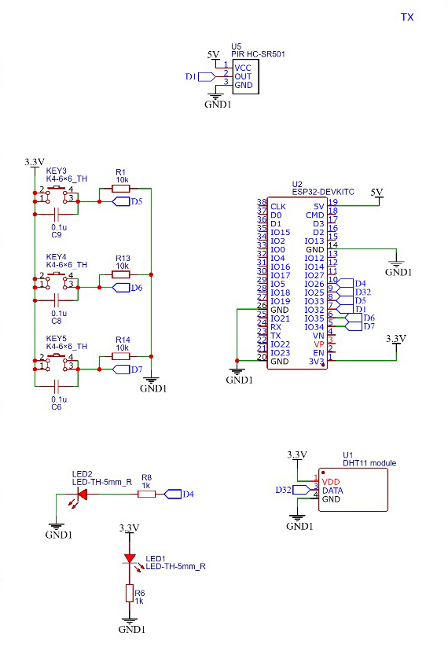
II. Schematic
DC Motor with wireless control

Slide 27
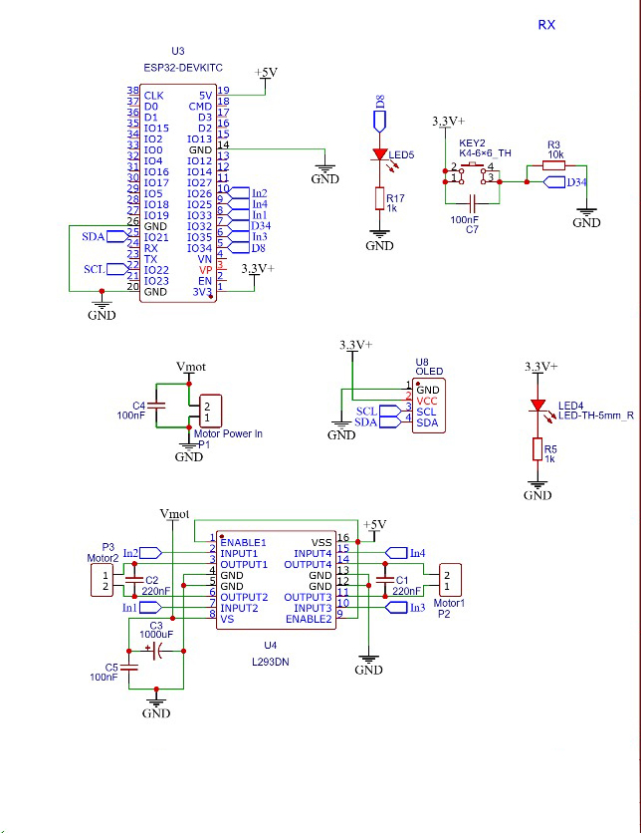
II. Schematic
DC Motor with wireless control

Slide 28
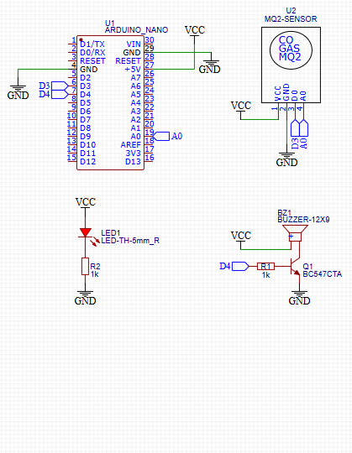
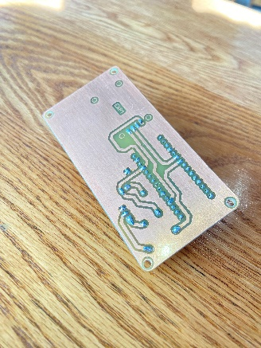
III. Experiment
Step 1
Connect the ESP32 Development Board
1. Connect the ESP32-DEVKITC board to your computer using a USB cable.
2. Open Arduino IDE on your computer to write the code.
3. Make sure the ESP32 board drivers are installed on Arduino IDE.
Step 2
Connect the Sensors
- PIR Sensor (U5):
Connect )VCC( to 5V.
Connect )GND( to GND.
Connect )OUT(to D1.
- DHT11 Sensor (U1):
Connect )DATA( to D32.
Connect )VCC( to 3.3V.
Connect )GND(to GND.

Slide 29
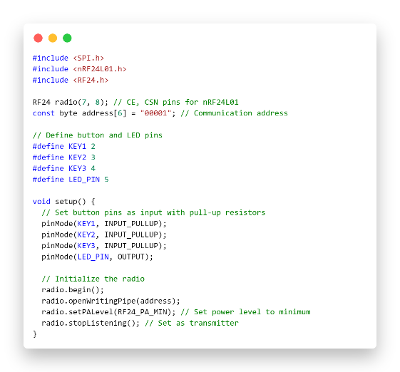
III. Experiment
Step 3
Install Required Libraries
Install the following libraries in the Arduino IDE via Library Manager:
RF24 (for nRF24L01 communication)
Adafruit SSD1306 (for the OLED display)
Adafruit GFX (required by the SSD1306 library).
Step 4
.Upload the Code
Copy the provided code into the Arduino IDE.
Connect the Arduino to your computer via USB.
Select the appropriate Board and Port from the Tools menu.
Upload the sketch to the Arduino.

Slide 30


III. Experiment
Step 5
Prepare the Transmitter
Ensure the transmitter is programmed to send commands ('F', 'B', 'S') to the same nRF24L01 address used in the receiver code.
Use a second Arduino or microcontroller for the transmitter setup.
Step 6
Power Up and Test the System
Power the receiver system (Arduino, nRF24L01, OLED, and motor driver).
Power the transmitter system.
Use the transmitter to send commands:
'F' for forward motion.
'B' for backward motion.
'S' to stop the motors.
Observe the OLED display for feedback on the received command and the motor's current action.

Slide 31
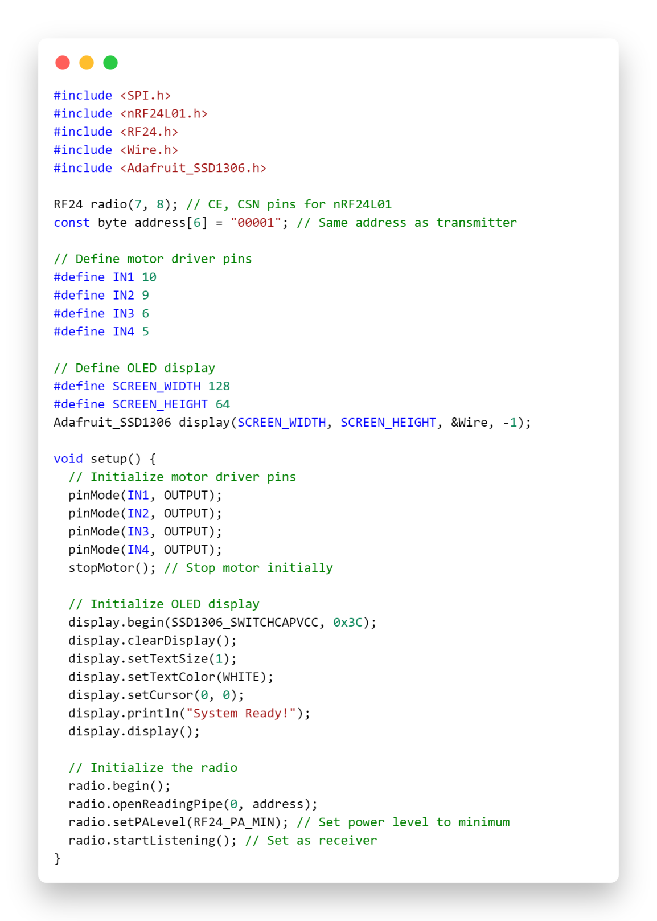
IV. Code
Receiver

Slide 32
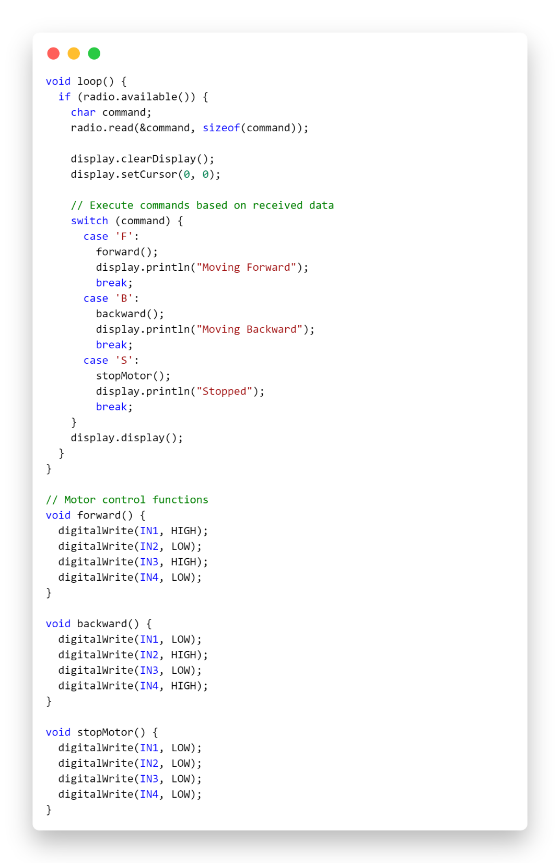
IV. Code
Receiver

Slide 33
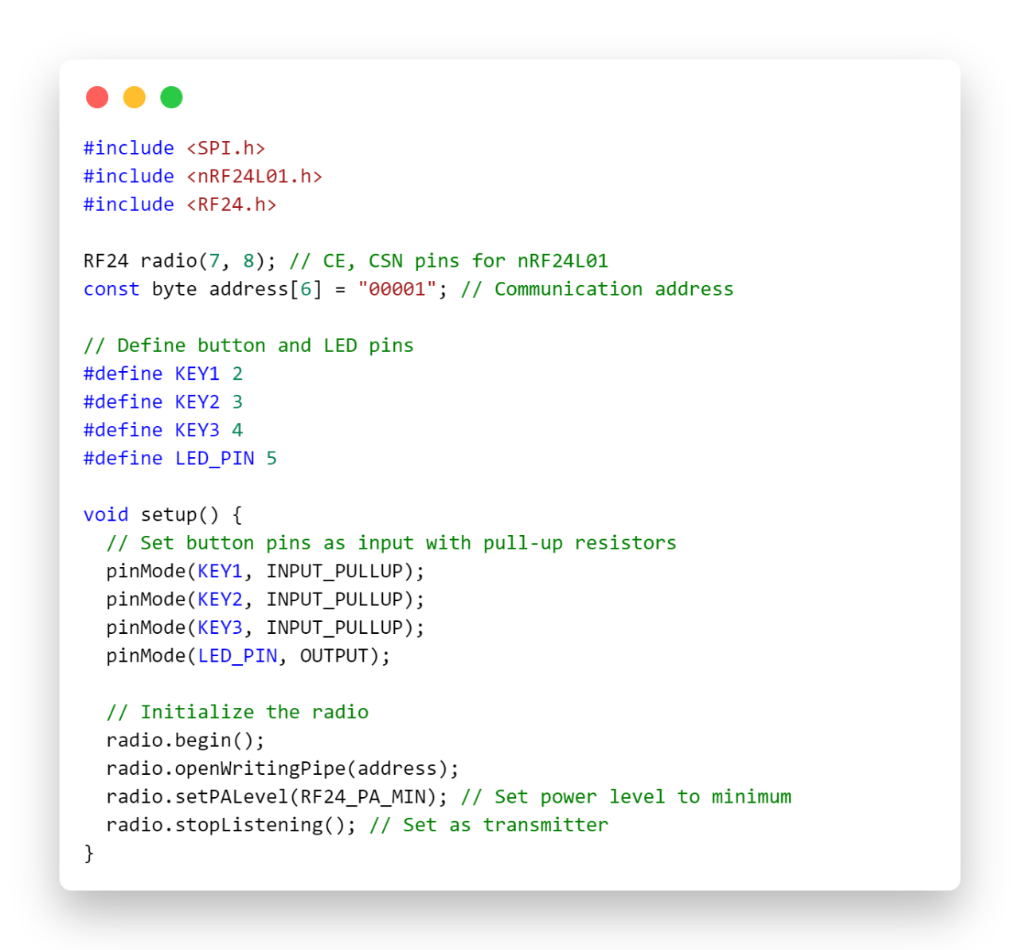
IV. Code
transmits

Slide 34
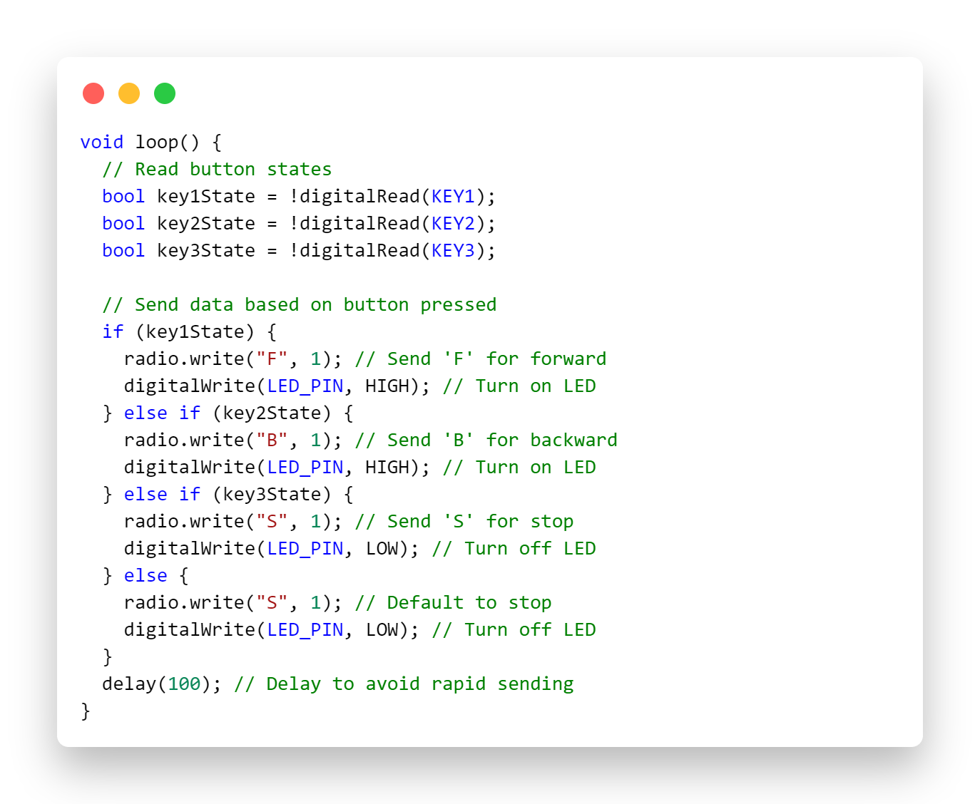
IV. Code
transmits

Slide 35

Experiment 3
Door lock control
An Electronic Locking System Using RFID Technology And A Microcontroller For Secure And Convenient Access. It Unlocks The Door Upon Detecting An Authorized RFID Card, With A Red LED Indicating System Power Only. Ideal For Homes, Offices, And Restricted Areas.

Slide 36


I. Components
1x Arduino Nano
A Compact Microcontroller Board That Acts As The Brain Of The PCB, Processing Sensor Data And Controlling Outputs Like Alarms And Leds.
1
1x MINI REID-RC522
A Module That Scans RFID Cards Or Tags And Sends Unique ID Data To The Arduino For Secure Access Control.
2
1x LCD HS 1602A
An LCD Display Device (HS1602A) That Shows A Warning Message When Triggered By The Circuit.
3

Slide 37



I. Components
1x DFPLAYER MINI MP3
An MP3 Playback Module (Dfplayer Mini) That Plays Audio Files When Triggered By The Circuit.
4
1x SPEAKER CONNECTOR
A Speaker Connector That Links An Audio Output Device To The Circuit For Sound Playback.
5
1x Solenoid Lock
A Solenoid Lock That Activates Or Unlocks When Triggered By The Circuit.
6

Slide 38


I. Components
1x 5N60 Transistor
A small signal NPN transistor that amplifies or switches electronic signals in the circuit.
7
2x LED
An LED indicator that lights up when triggered by the circuit, serving as a visual signal for specific events.
8
5x 1k Ohm Resistor
Components used to limit current flow, protecting sensitive parts of the circuit from damage.
9

Slide 39


I. Components
1x Diode 1N4007
That Protects The Circuit By Blocking Reverse Current And Ensuring Safe Operation Of Connected Components.
10
2x Capacitor
A Capacitor That Stores And Releases Electrical Energy In The Circuit, Used For Filtering, Smoothing, Or Stabilizing Voltage.
11
2x 10k Ohm Resistor
Components Used To Limit Current Flow, Protecting Sensitive Parts Of The Circuit From Damage.
12

Slide 40
II. Schematic
Door lock control
Reference | Component | Value | Quantity
LCD1 | LCD Display | -- | 1
U1 | Arduino Nano | -- | 1
U2 | RFID Module | -- | 1
U4 | MP3 Player Module | -- | 1
P2 | Solenoid Lock | -- | 1
P1 | Ext Power Connector | -- | 1
P3 | Speaker Connector | -- | 1
R1, R2, R3, R4, R5 | Resistors | 1kΩ | 5
R6, R7 | Resistors | 10kΩ | 2
C1 | Capacitor | 220µF | 1
C2 | Capacitor | 1µF | 1
D3 | Diode | -- | 1
Q2 | Transistor | NPR | 1
LED3, LED4 | LED | -- | 2

Slide 41

II. Schematic
Door lock control

Slide 42

III. Experiment
Step 1
Connect the Arduino Nano
Plug the Arduino Nano into your computer using a USB cable.
Open the Arduino IDE on your computer to begin writing the code.
Step 2
Assemble the Circuit
Connect the components based on the provided schematic:
Attach the RFID module to the Arduino Nano via SPI communication pins.
Connect the solenoid lock using a transistor for control, with a flyback diode for protection.
Attach the LCD display to display system status (e.g., "Scan Card" or "Access Granted").
Connect the MP3 player module for audio feedback and attach the speaker.
Add power and unlock indicator LEDs, with resistors to limit current.
Use capacitors to stabilize the power supply.

Slide 43

III. Experiment
Step 3
Write the Code
In the Arduino IDE, write a program to:
Read RFID card data using the RFID module.
Compare the card data against a list of authorized Ids stored in the code.
Trigger the solenoid lock and play an "access granted" sound if the card is authorized.
Blink the unlock LED for visual feedback.
Display appropriate messages on the LCD (e.g., Unauthorized" or "Access Granted").
Step 4
Compile and Upload the Code
Compile the code in the Arduino IDE to ensure there are no errors.
Upload the code to the Arduino Nano using the "Upload" button.

Slide 44


III. Experiment
Step 5
Assemble the PCB
Disconnect the Arduino Nano from the USB cable.
Connect it to the PCB according to the schematic.
Secure all components in their designated positions on the PCB.
Step 6
Test Your Code
Power the circuit using the external power supply.
Scan an RFID card:
If authorized, the solenoid lock should disengage, allowing the door to open.
The unlock LED should blink, and the MP3 module should play the "access granted" sound.
If unauthorized, the lock remains engaged, and the LCD displays "Access Denied."

Slide 45

III. Experiment
Step 7
Troubleshooting
If the solenoid lock doesn't operate or the system behaves unexpectedly:
1. Recheck all connections against the schematic.
2. Verify the code and re-upload it if necessary.
3. Ensure the power supply provides sufficient voltage and current.

Slide 46

IV. Code

Slide 47

IV. Code

Slide 48

Experiment 4
Water Level Measurement With Ultrasonic
A Water Level Measurement System Using Ultrasonic Technology And A Microcontroller To Monitor And Display The Water Level In A Tank. The Ultrasonic Sensor Measures The Distance Between The Sensor And The Water Surface, And The Data Is Processed By The Microcontroller. The Results Are Displayed On An LCD, Providing A Clear And Real-time Indication Of Water Levels. Ideal For Use In Homes, Agriculture, And Industrial Water Management Systems.

Slide 49

I. Components
1x Arduino nano
A compact microcontroller board that acts as the brain of the PCB, processing sensor data and controlling outputs like alarms and LEDs.
1
1x Ultrasonic Sensor (HC-SR04)
Measures distance by emitting sound waves and detecting their echo. Used in water level monitoring and obstacle detection.
2
1x LCD HS 1602A
An LCD display device (HS1602A) that shows a warning message when triggered by the circuit.
3

Slide 50

I. Components
1x Buzzer
An audio output device that produces a sound alarm when triggered by the circuit. Ideal for notifications and alerts.
4
1x 10k Ohm Resistor
Components used to limit current flow, protecting sensitive parts of the circuit from damage.
5
1x 220k Ohm Resistor
Components used to limit current flow, protecting sensitive parts of the circuit from damage.
6

Slide 51

I. Components
1x BC547 Transistor
A small NPN transistor used to amplify or switch electronic signals in the circuit.
7
1x LED
An LED indicator that lights up when triggered by the circuit, serving as a visual signal for specific events.
8
2x 1k Ohm Resistor
Components used to limit current flow, protecting sensitive parts of the circuit from damage.
9

Slide 52
II. Schematic
water level measurement with ultrasonic
Reference | Component | Value | Quantity
LCD1 | LCD Display | -- | 1
U1 | Arduino Nano | -- | 1
U2 | Ultrasonic Sensor | -- | 1
BUZZER1 | Buzzer | -- | 1
Q1 | Transistor | -- | 1
R1, R6 | Resistors | 1kΩ | 2
R3 | Resistor | 10kΩ | 1
R4 | Resistor | 220Ω | 1
LED1 | LED | -- | 1

Slide 53

II. Schematic
Water Level Measurement With Ultrasonic

Slide 54

III. Experiment
Step 1
Connect the Arduino Nano
Plug the Arduino Nano into your computer using a USB cable.
Open the Arduino IDE on your computer to begin writing the code.
Step 2
Gather and Connect Components
1. Attach the ultrasonic sensor (HC-SR04) to the Arduino Nano according to the schematic.
- TRIG pin to a digital pin on the Arduino.
- ECHO pin to another digital pin on the Arduino.
- VCC and GND to the respective power pins.
2. Connect the LCD (HS1602A) to the Arduino using appropriate pins. Use a potentiometer to adjust the contrast.
3. Power the system using an external power source or USB cable.

Slide 55

III. Experiment
Step 3
Write the Code
Using the Arduino IDE, write a program to:
- Send trigger pulses to the ultrasonic sensor.
- Calculate the distance by measuring the time taken for the echo pulse.
- Convert the distance into water level height.
- Display the water level percentage or height on the LCD.
Step 4
Test the Sensor
Test the ultrasonic sensor by measuring distances in different scenarios. Ensure it accurately reads and displays the water level.

Slide 56


III. Experiment
Step 5
Assemble the PCB
After verifying the functionality, disconnect the Arduino from the computer and assemble the components on the PCB. Secure the ultrasonic sensor, LCD, and other components in their designated positions.
Step 6
Calibrate the System
Calibrate the ultrasonic sensor based on the tank's dimensions. Modify the code to reflect the tank's full and empty water levels.

Slide 57

III. Experiment
Step 7
Troubleshooting
If the system behaves unexpectedly:
1. Recheck all wiring connections.
2. Verify and re-upload the code.
3. Ensure the power supply is sufficient for the components.

Slide 58

IV. Code

Slide 59

IV. Code

Slide 60

Experiment 5
Smart Irrigation System
An ESP32 MQTT Irrigation System Is A Smart Irrigation Setup That Uses The ESP32 Microcontroller And The MQTT Protocol To Automate Watering Plants Based On Soil Moisture Levels Automatic System Watering Arduino Using Circuit Plants Diagram Water Plant Irrigation Pump Sensor Build Soil Moisturewatering Arduino Circuit Moisture Soil Ozeki Kindpng Automatic Plant Watering Project Using Arduino |Arduino Smart Irrigationsystem Plant Watering Automatic Diagram Schematic Arduino Water Moisture Module Working Gadgetronicx Explanation.

Slide 61



I. Components
1x Oled ssd1306 0.96in
OLED (Organic Light Emitting Diode) displays offer excellent color accuracy, deep blacks, and energy efficiency, widely used in smartphones, TVs, and wearable devices
1
1x Water Pump
is a versatile and efficient tool used in various applications, from automotive and marine to gardening and home use.
2
1x Capacitive Soil Moisture Sensor V1.2
A capacitive soil moisture sensor is a durable, corrosion-resistant tool for monitoring soil moisture levels.
3

Slide 62



I. Components
1x IRFZ44N
Is an N-channel power MOSFET used in various electronic circuits due to its high current capacity and low on-resistance.
4
1x Risistor 10Ω
in various electronic circuits to limit current, divide voltage, or provide a specific resistance value.
5
1x ESP32 board
A popular IoT board with a micro-USB port for power and programming, featuring capacitors, resistors, and a metal shield covering the ESP32 chip.
6

Slide 63





I. Components
Terminal Block
Terminal Block used for connecting wires to a PCB.
7
1N4007
The 1N4007 is a popular general-purpose rectifier diode.
8
A 100µF 10V A capacitor
used for filtering, decoupling, and energy storage in various applications.
9
9

Slide 64
II. Schematic
ESP32 MQTT irrigation
Reference | Component | Value | Quantity
U1 | ESP32 | Wi-Fi & Bluetooth MCU | 1
U2 | Capacitive Soil Moisture Sensor V1.2 | V1.2 | 1
D3 | OLED Display | SSD1306 0.96in | 1
P1 | water pump | -- | 1
R1 | Resistor | 10kΩ | 1
J1 | Terminal Block | 2 Pins KF126-5.0-2P | 1
D2 | Diode | 1N4007 | 1
D1 | Driver (MOSFET or Relay) | N-channel MOSFET or Relay | 1
LED1 | Red LED | -- | 1
LED2 | Blue LED | -- | 1
C1 | Capacitor | 100uF 10V | 1

Slide 65

II. Schematic

Slide 66
III. Experiment
Step 1
Connect the 3.3V power supply and battery to the circuit at P2.
Use capacitor C1 (220uF) to filter the power supply and ensure stable voltage.
Step 2
Understand the Connections from the Schematic
Place the ESP32-DEVKITC microcontroller (U1) at the center of the circuit.
Connect pin 13 (D13) of the ESP32 to the moisture sensor (J1).
Connect pins 22 (SCL) and 21 (SDA) of the ESP32 to the OLED display (U8).
Connect pin 19 (D19) of the ESP32 to the gate of the MOSFET transistor (Q1).

Slide 67

III. Experiment
Step 3
Write the Code
Connect the moisture sensor (J1) to pin 13 (D13) of the ESP32.
The sensor will measure the soil moisture level and send the data to the ESP32.Connect the OLED display (U8) to the ESP32 using I2C communication via pins 22 (SCL) and 21 (SDA).
The display will show the moisture level and other relevant information.
Step 4
Test the Sensor
Test the ultrasonic sensor by measuring distances in different scenarios. Ensure it accurately reads and displays the water level.

Slide 68


III. Experiment
Step 5
LED Indicator:
- Connect an LED (LED1) to the VCC and ground through a 1k resistor (R6).
- The LED serves as a power indicator, lighting up when the circuit is powered.
Step 6
Calibrate the System
Use R1 (1k) and R2 (10k) for current limiting and voltage division, C2 (1uF) for filtering, and D1 (1N4007) for reverse voltage protection. Program the ESP32 to connect to WiFi, read moisture sensor data, control the water pump, and publish data to an MQTT topic while subscribing to control commands.

Slide 69

III. Experiment
Step 7
Troubleshooting
If the system behaves unexpectedly:
1. Recheck all wiring connections.
2. Verify and re-upload the code.
3. Ensure the power supply is sufficient for the components.

Slide 70

IV. Code

Slide 71
IV. Code

Slide 72

Experiment 6
Lora WAN
Lora WAN Is A Revolutionary Wireless Communication Protocol Specifically Designed For The Internet Of Things (Iot). It's Like A Specialized Language That Allows Devices To "Talk" To Each Other Over Long Distances While Using Very Little Power . It Leverages The Lora Radio Modulation Technique, Enabling Long-range, Low-power, And Cost-effective Data Transmission Over Wide Areas.

Slide 73


I. Components
2x Arduino nano
A compact microcontroller board that acts as the brain of the PCB, processing sensor data and controlling outputs like alarms and LEDs.
1
2x LoRa Modules
They are compact, integrated circuits that contain all the necessary hardware and firmware to enable long-range, low-power wireless communication
2
1x LCD
An LCD is a flat-panel display that uses liquid crystals to modulate light and create images. It doesn't emit light directly but relies on a backlight or reflector to produce the image.
.
3

Slide 74


I. Components
4x push btn
is a small, interactive component that users press to initiate a specific function or command. Typically found on devices like calculators, remote controls, and keypads, each button is labeled with a digit, symbol, or letter, enabling straightforward input and control.
4
2x Voltage Regulators
These components are used to regulate the voltage supply to different parts of the circuit.
5
1x 1k Ohm Resistor
Components used to limit current flow, protecting sensitive parts of the circuit from damage.
6

Slide 75
II. Schematic
Reference | Component | Value | Quantity
U3 | Sensor Module | DHT11 | 1
U8 | Display | OLED (I2C) | 1
U2, U9.5 | Module | LoRa RA02 SX1278 | 2
J1, J2, J3 | Connector | Header 2x3 | 3
KEY1, KEY2, KEY3, KEY5 | Push Button | K4-6+6_TH | 4
U3 | Sensor Module | DHT11 | 1
R1, R2, R3, R4, R5, R6, R10, R11, R12, R32 | Resistor | 10kΩ | 10
C1, C2, C3, C4, C5, C6 | Capacitor | 10µF | 6
D1, D2, D3, D4, D5 | LED (Diode) | RGB LEDs | 5
U1, U18 | Microcontroller | Arduino Nano | 2
U5, U6 | Voltage Regulator | AMS1117-3.3RG | 2
U7.1, U7.2, U7.3, U7.4, U10.1, U10.2, U10.3, U10.4 | Buffer IC | SN74LVC125ADE4 | 8

Slide 76

II. Schematic

Slide 77

II. Schematic
LoRa WAN

Slide 78


III. Experiment
Step 1
Connect the Arduino Nano
Plug the Arduino Nano into your computer using a USB cable.
Open the Arduino IDE on your computer to begin writing the code.
Step 2 :
Assemble the Circuit
Follow these steps to build the circuit:
1. Connect the LoRa module (RA-02) to the Arduino Nano:
- MISO → D12
- MOSI → D11
- SCK → D13
- NSS → D10
- GND → GND
- VCC → 3.3V (regulated by AMS1117).
2. Attach the DHT11 sensor:
- VCC → 3.3V
- DATA → D6
- GND → GND.
3. Connect the OLED display:
- SDA → A4
- SCL → A5.
4. Add LEDs to D2, D3, D4, and D5 with 1kΩ resistors.
5. Wire push buttons to D7 and D8 with 10kΩ pull-down resistors.

Slide 79

III. Experiment
Step 3
Write the Code
Using the Arduino IDE, write the program to:
1. Read data from the DHT11 sensor.
2. Display the data on the OLED screen.
3. Transmit the data via LoRa.
4. Blink LEDs or update based on received signals.
5. Respond to push-button inputs.
Step 4
Upload the Code
1. Compile the program in the Arduino IDE.
2. Upload the program to the Arduino Nano via USB.
3. Open the Serial Monitor to confirm the code is running properly.

Slide 80
III. Experiment
Step 5
Test the System
1. Power the circuit through USB or an external power supply.
2. Verify that the OLED displays real-time sensor data.
3. Ensure the LoRa modules can transmit and receive data correctly.
4. Check that LEDs respond to events and buttons trigger desired actions.
Step 6
Troubleshooting
If the system does not work as expected:
1. Recheck all circuit connections.
2. Ensure the LoRa module frequency settings match.
3. Verify the code logic and re-upload if necessary.
4. Test the power supply to confirm sufficient voltage and current.

Slide 81

III. Experiment
Step 7
Finalize the Project
1. Once testing is successful, solder the components onto a PCB for a permanent setup.
2. Secure the system in an enclosure to protect the hardware.
3. Deploy the project in your desired location, ensuring the LoRa modules are within communication range for effective data transmission.

Slide 82

IV. Code
Receiver

Slide 83

IV. Code
Transmitter

Slide 84

Experiment 7
ESP32-CAM Streaming and Remote Control
The car is designed to be controlled remotely via a controller, allowing for navigation and operation. The ESP32-CAM streams live video to a web application, enabling users to see what the camera captures in real-time. This integration of components facilitates an interactive and engaging experience, combining mobility with visual feedback.

Slide 85



I. Components
2x dc motor
A DC motor is an electrical device that converts direct current (DC) electrical energy into mechanical energy through magnetic forces. They are commonly used in various applications due to their simplicity and ease of control.
1
1x Chassis
A gas-detecting component that identifies smoke or specific gases and sends corresponding data to the Arduino.
2
1x Esp32 cam
The ESP32-CAM is a compact and cost-effective development board that combines the capabilities of the ESP32 microcontroller with a camera module, making it ideal for various IoT and embedded applications.
3

Slide 86



I. Components
1x Driver l298n
The L298N is a popular dual H-bridge motor driver IC that allows you to control the direction and speed of DC motors and stepper motors.
4
1x Regulator 5 volt
A 5V voltage regulator is an electronic component that provides a stable output voltage of 5 volts, regardless of variations in the input voltage or load conditions..
5
Battery holder
A battery holder is a device designed to securely hold one or more batteries in place while providing electrical connections to the battery terminals.
6

Slide 87

II. Diagram
ESP32-CAM Streaming and Remote Control
Component | Value | Quantity
dc motor | 640 rpm | 2
Chassis | -- | 1
Esp32 cam | -- | 1
Driver l298n | -- | 1
Regulator | 5V | 1
Battery holder | 4 slots | 1

Slide 88


III. Experiment
Step 1
Connect the Esp8266 & esp_cam
Plug the Esp8266 & esp-cam into your computer using a USB cable.
Open the Arduino IDE on your computer to begin writing the code.
Step 2
Understand the Connections from the diagram
Refer to the schematic diagram to identify how the components are connected:
MQ Gas Sensor:
A0 (sensor) → A0 (Arduino Nano)
D0 (sensor) → D3 (Arduino Nano)
Buzzer: D4 (Arduino Nano) → Positive terminal of buzzer
R2 (Power Indicator): Connected to indicate power to the PCB.

Slide 89

III. Experiment
Step 3
Write the Code for esp cam
In the Arduino IDE, write the program to:
Write the wifi network details.
Make the ip static.
Stream the video from the esp cam.
You can either use esp cam example or scan this qr to get the full code
Use the diagram as a reference to ensure the correct pin assignments in your code.
Step 4
Compile and Upload the Code
Compile the code in the Arduino IDE to ensure there are no errors.
Upload the code to the esp cam(AI thinker) using the "Upload" button.

Slide 90

III. Experiment
Step 5
Assemble the car and check the power
Carefully ensure the voltage for each component knowing that both esp cam, esp8266 receive 5V while the motor driver 12V
Step 6
Test Your Code
Power on the Car:
Connect to your wifi network.
Open your browser and visit the car’s ip
Start moving the car around using the web buttons.

Slide 91

III. Experiment
Step 7
Troubleshooting
If the stream doesn’t start recheck the esp cam voltage ensuring it is getting its right volt and ampere.
If the car movement isn’t right try swapping the motor pins.

Slide 92

TEAM
Smart City
ID | الاسم بالإنجليزية | الاسم بالعربية
2220016 | Ahmed Hassan El-Husseini Khtan | احمد حسن الحسيني
2220025 | Ahmed Samir Ibrahim Darwish | احمد سمير ابراهيم درويش
2220037 | Ahmed Mohamed Ahmed El-Sayed Saleh | احمد محمد احمد السيد
2220046 | Ahmed Mohamed Fathy Mohamed | أحمد محمد فتحي محمد
2220047 | Ahmed Mohamed Gad | احمد محمد جاد
3330031 | Ahmed Abdelhamid Saqr | احمد عبد الحميد صقر
2220103 | Ibrahim Saleh Ibrahim | ابراهيم صالح ابراهيم
2220117 | Basma Mahmoud Mohamed Mahmoud | بسملة محمود محمد محمود
2220130 | Jumana Mohamed Hassan Abouzeid | جمانه محمد حسن ابوزيد
2220169 | Rawan Rabie El-Said Mahmoud | روان ربيع السعيد محمود
2220170 | Rawan Magdy Ezzat Anbar | روان مجدي عزت عنير
2220172 | Rawan Yasser Hassan Ahmed | روان ياسر حسن احمد
2220180 | Ziad Hassan Mohamed Mohamed | زياد حسن محمد محمد
2220200 | Salma Atef Mohamed | سلمي عاطف محمد
2220205 | Saif Eldin Saber Mohamed | سيف الدين صابر محمد
2220214 | Sherif Hamdy Mohamed El-Sayed | شريف حمدي محمد السيد
2220219 | Shahd Mohamed Abdelsamad Abdelhady | شهد محمد عبدالصمد
Team leader
1-Ziad Hassan Mohamed Mohamed 2220180
2- Abdelhamid Ahmed 2220556
3- Youssef Mohamed Ali 2220536
4- Omar Mohamed Ali El-Gamal 2220315

Slide 93
TEAM
Smart City
ID | الاسم بالإنجليزية | الاسم بالعربية
2220271 | Abdullah Mohamed Gharib | عبدالله محمد غريب شحاته
2220281 | Abdelrahman Samir Saad | عبدالرحمن سمير سعد مندور
2220285 | Abdelrahman Mohamed Said | عبدالرحمن محمد سعيد محمد
2220315 | Omar Mohamed Ali El- Gamal | عمر محمد محمد علي الجمل
2220415 | Mohamed Medhat Hassan Ali | محمد مدحت حسن علي
2220466 | Mostafa Ismail Fahmy Mostafa | مصطفى اسماعيل فهمي مصطفى
2220469 | Mostafa Ayman Khalaf | مصطفى ايمن خلف زغلول
2220499 | Nada Hany Mohamed | ندي هاني محمد محمود
2220505 | Nour Mohamed Hafzy | نور محمد حفظي
2220510 | Hager Suleiman | هاجر سليمان
2220527 | Youssef Bahgat Ezzat Ahmed | يوسف بهجت عزت احمد
2220536 | Youssef Mohamed Ali | يوسف محمد علي محمود علي
2220556 | Abdelhamid Ahmed | عبدالحميد احمد عبدالحميد
2220221 | Shaimaa Mohamed Abdel-Maqsoud | شيماء محمد عبد المقصود
2220255 | Abdelrahman Mohamed | عبد الرحمن محمد السيد حسين
2220256 | Abdelrahman Mohamed | عبدالرحمن محمد احمد
Team leader
1-Ziad Hassan Mohamed Mohamed 2220180
2- Abdelhamid Ahmed 2220556
3- Youssef Mohamed Ali 2220536
4- Omar Mohamed Ali El-Gamal 2220315

Slide 94

Borg Al Arab Technological University
Your Electronics Journey Begins Here
Thank you for exploring our electronics collection. Each PCB is designed with innovation and precision.

